Slide 1
WI：SLB-mmW meeting # Concept
Date: 2024-11-20
Source:
Affiliations | Contact | Email
Huawei Technologies. Co. Ltd | Xu Li | lixu11@huawei.com

Slide 2
Contents
Motivation
Requirements
Key Aspects
Numerology
Non-Standalone
Multi-Antenna
High Data Rate
Distance Enhance

Slide 3
Motivation
mmWave has wideband spectrum to provide high data rate.
The related modules of amplifier, mixer, filters, etc, are well developed in recent years, and can be obtained from the market.
Ultra-high-speed commercial applications are exploding.
Fiber to the Room:
Users in different adjacent rooms/offices can download mass data (e.g. video/audio clip, e-magazine, picture library etc.) from a fixed device. 100 jpeg (picture) files of 5MB takes 0.6 second over a single hop 10Gbps link;
Latency 1-10 ms may be acceptable. More than 10 ms may not be acceptable.
Kiss connectivity Communications
Users can download mass data (e.g. video/audio clip, e-magazine, picture library etc.) from a fixed device. 100 jpeg (picture) files of 5MB takes 0.6 second over a single hop 10Gbps link.
Jitter is not critical. The key metric is the user’s time spent to do a transfer. Less than 1 second is acceptable. 1-5 seconds may be acceptable. More than 5 seconds may not be acceptable.
Augmented Reality/Virtual Reality Headsets and Other High-End Wearables
User plays a game, watches a movie, etc. using his high-end wearable, which is communicating with the managing device (e.g. gaming console, smartphone). Both devices must be able to tolerate moderate user movement.
Data rate at ~20 Gbps, latency < 5 ms, jitter <5 ms, PER<10E-2
Video/Mass-Data Distribution/Video on Demand (VOD) System
The HD video/mass-data information can be distributed to the individual users simultaneously (broadcast). For example, there are multiple screens that show the same video in a exhibition or gymnasium. Students watch the same courseware on the screen of their own device.
Users can use VOD system to watch moves/videos in which they are interested.
Mobile Fronthauling
Generally BBU and RRHs are connected by optical fibers. However, especially in rural areas or in disaster areas, optical fibers are unavailable. In such areas, cellular areas can be easily expanded by using SLM links.
The data transfers at ~20 Gbps. High reliability and availability (99.99%).
Others

Slide 4
Requirements
 | 5G mmWave | 802.11ad/ay | SLB mmWave
Scenarios | High throughput | High throughput | High throughput, frequency reuse in dense scenario
Waveform (mandatory) | OFDM | Single carrier | OFDM
Minimum Bandwidth | 50 MHz | 2.16 GHz | hundreds MHz
Maximum bandwidth | 800 MHz (2 GHz?) | 8.64 GHz | GHz (Optional)
Peak throughput | (6.5+6.9) Gbps/ss, where 6.9 is from sub 6GHz | 34.65 Gbps/ss | tens Gbps/ss
Latency | Low | High | Low
Transmission mode | schedule | random access | schedule
Mode | non-standard alone | standard alone | non-standard alone
Connection maintain | Yes | No (blockage issue) | Yes
Cost | High | High | Low
Complexity | Medium | High | Low

Slide 5
PHY Numerology (Based on 1.0 bis)
A limited set of bandwidth (choosing a set of BWs between 160 and 2560 MHz for instance)
For example: upclock SLB by 8 times
For example: carrier aggregation
SLB PHY numerology
mmWave PHY numerology
 | 20 | 40 | 80 | 160
 | 30.72 | 61.44 | 122.88 | 245.76
N_{DFT} | 256 | 512 | 1024 | 2048
ΔF | 120 KHz
T_{DFT} | 8.333 μs
 | 160 | 320 | 640 | 1280
N_{DFT} | 256 | 512 | 1024 | 2048
ΔF | 960 KHz
T_{DFT} | 0.5208 μs
x8
160 MHz
160 MHz
160 MHz
160 MHz
160 MHz
160 MHz
160 MHz
160 MHz
320 M
640 M
Situation1: Numerology on SLB mmW, re-use but with larger subcarrier spacing of that on SLB low band.
Situation2: Carrier Aggregation on SLB mmW, re-use but with larger bandwidth of that on SLB low band.

Slide 6
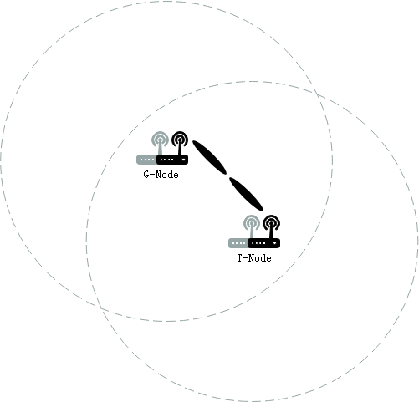
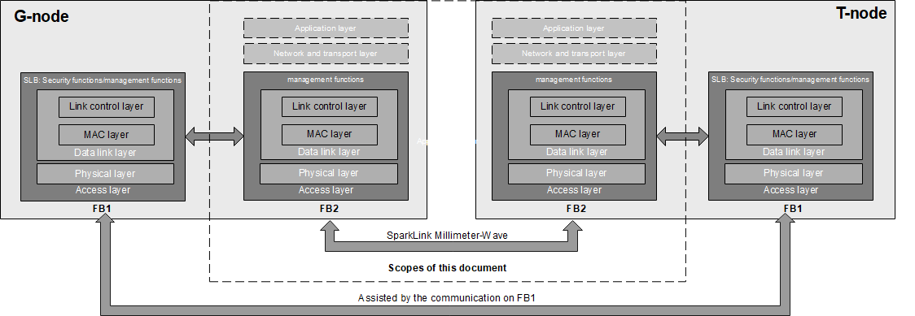
Non-Standalone
SLB mmW is assisted by the communication at SLB low band
Omnidirectional coverage is provided at low band
Narrow Beams and large bandwidth with high data-rate capability is provided at SLB mmW
FB1: low frequency
FB2: mmW
System Architecture
Protocol Architecture
Situation: Non-Standalone is the new and indispensable feature of SLB-mmW.

Slide 7
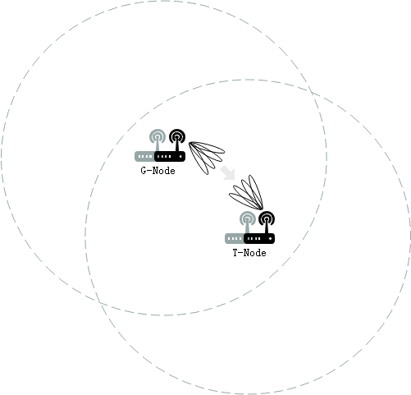
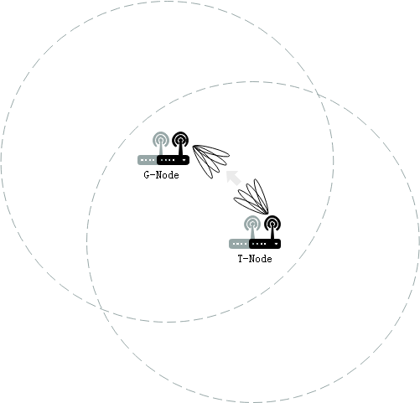
Multi-Antenna
…
Multiple Antennas
Beam Sweep for G-Link on mmW
Beam Sweep for T-Link on mmW
Multiple antennas are deployed at G-node and T-node to compensate the path loss.
The beam management for G-Link on mmW from G-node to T-node.
The beam management for T-Link on mmW from T-node to G-node.
The beam management on mmW is assisted by the communication on low band.
Whether to support both links or be simplified due to channel reciprocity depends.
Situation: Multi-antenna with Beam Management is the new and indispensable feature of SLB-mmW.

Slide 8
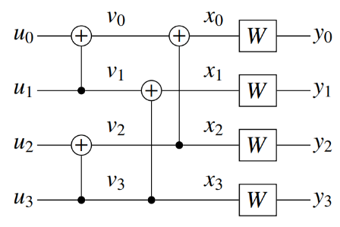
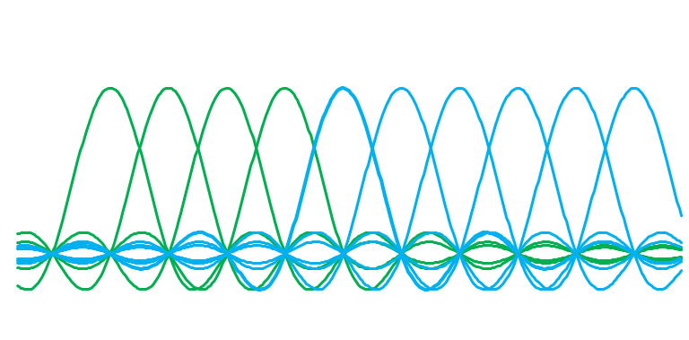
High Data Rate
Large Bandwidth with OFDM symbol aligned in frequency-domain
Polar Code
Large Bandwidth with OFDM symbol aligned in frequency, where the alignment reduces adjacent CC interference
Polar code is employed in both control plane and data plane
Compared with non-coding, the anti-interference capability is improved
Situation: Polar Code is supported by SLB low band, which needs to be enhanced with large block on mmW.

Slide 9
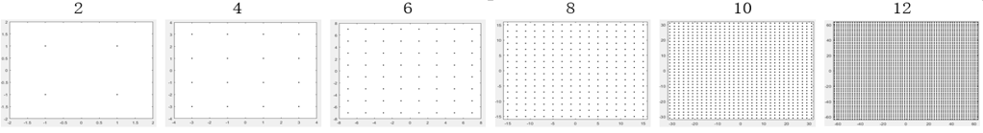
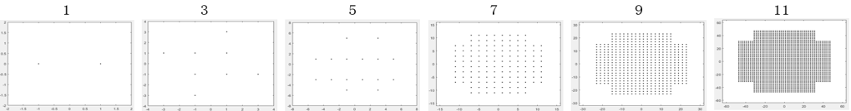
Distance Enhance
Example: Non-uniform Modulation
Distance enhance technologies need to be studied to extend the communication distance of SLB-mmW
Non-uniform modulation is a candidate technology, where the Probabilistic Shaping with non-uniform probability and Geometric Shaping with non-uniform constellation can be studied.
Situation: Distance Enhance is the new and un-certain feature of SLB-mmW.

Slide 10
Thanks and Welcome all to Work Together on SparkLink mmW International Standard Cheers!

